Slide 1
A Study Of The Book Of Revelation
November 8, 2020

Slide 2
Resources used:
A Study Of The Book Of Revelation by Bob Dodson
More Than Conquerors by William Hendriksen
Overcoming With The Lamb, Florida College Annual Lectures, February 7-10, 1994
Revelation: An Introduction and Commentary by Homer Hailey
Revelation (Truth Commentaries) by Robert Harkrider
Revelation (A Study Workbook) by Robert Harkrider
Revelation by Donnie Rader
Revelation charts by Keith Greer.
Studies In The Book Of Revelation by Ferrell Jenkins
The Old Testament In The Book Of Revelation by Ferrell Jenkins
The Revelation Of Saint John The Divine by G.B. Caird
The Book of Revelation by Foy E. Wallace
The Avenging of the Apostles and Prophets by Arthur M. Ogden
Worthy Is The Lamb by Ray Summers
Written exchange on “The Domitian Persecution” between Arthur M. Ogden and Ferrell Jenkins presented in Searching The Scriptures, June 12, 1989, pages 7-12

Slide 3
Revelation
I. Struggle on Earth (1-11)
A. John’s Vision (1)
B. Letters to 7 churches (2-3)
C. God in control (4-5)
D. Opening of seven seals (6-11)

Slide 4
Revelation 9
“Fifth and Sixth Trumpets”
Outline
The Fifth Trumpet: The Locusts (verses 1-12)
The Sixth Trumpet: Angels and Horsemen (verses 13-21)

Slide 5
Revelation 9
“Fifth and Sixth Trumpets”
Outline
The Fifth Trumpet: The Locusts (verses 1-12)
Their source (verses 1-3a)
Their mission (verses 3b-6)
Their description (verses 7-10)
Their king (verses 11-12)

Slide 6
Revelation 9
“Fifth and Sixth Trumpets”
MAIN THEME: The transgressor who will not repent brings destruction upon himself as well, as he shall feel the wrath of almighty God! (Proverbs 11:3, 5, 6, 17, 19, 21, 23, 27, 29, 31).
Should I really envy the prosperity of wicked?
Should I fret because it seems like the wicked have the fat of the earth?

Slide 7

Revelation 9:1
Revelation 9
“And the fifth angel sounded, and I saw a star from heaven fallen unto the earth: and there was given to him the key of the pit of the abyss.”

Slide 8
Revelation 9:2
Revelation 9
“And he opened the pit of the abyss; and there went up a smoke out of the pit, as the smoke of a great furnace; and the sun and the air were darkened by reason of the smoke of the pit.”

Slide 9
The Fifth Angel
Revelation 9
Star falls from heaven (Agent of Satan personified).
“When Jesus said in Luke 10:18, ‘I beheld Satan fall as lightning from heaven,’ he meant the complete defeat of all the personified agents of Satan. By his fall from heaven, Jesus meant that Satan would be dethroned from his exalted dominion; and his downfall would come swiftly as lightning in the shaping conflict.” (Foy Wallace)
In Isaiah 14:12 The prophet spoke of a Babylonian ruler. It referred to the downfall of the ruler, personified as Lucifer.
The name Lucifer in the Septuagint, is translated “Star,” which was represented as falling from heaven – the wicked king’s exalted place of dominion.

Slide 10
The Fifth Angel
Revelation 9
Star falls from heaven (Agent of Satan personified).
Satan defeated. Hebrews 2:14-15
Given the key to the bottomless pit.
The pit was open.
Smoke like the smoke of a great furnace escaped from the pit.
The great smoke darkened the sun and air.

Slide 11
The Fifth Angel
Revelation 9
The fifth trumpet sounds the warnings as the devilish forces are unleashed.
They shall torment those who do not have the “seal of God on their foreheads” (saints). cf. 7:2-3
Punishment is unleashed on those who have committed heinous crimes against God and His people.

Slide 12
The Fallen Star
Revelation 9
The star “a messenger” came from heaven to earth.
Perhaps personifying Satan. (Revelation 11:7; 17:8; 20:1-3)
Key to the “abyss” (bottomless pit)
This is the abode of demons. (Luke 8:31)
Preliminary punishment for fallen angels, the beast (17:8)
Final abode for Satan himself (20:3)
Satan has control over the demonic forces

Slide 13
Revelation 9:3
Revelation 9
“And out of the smoke came forth locusts upon the earth; and power was given them, as the scorpions of the earth have power.”

Slide 14
Revelation 9:4
Revelation 9
“And it was said unto them that they should not hurt the grass of the earth, neither any green thing, neither any tree, but only such men as have not the seal of God on their foreheads.”

Slide 15
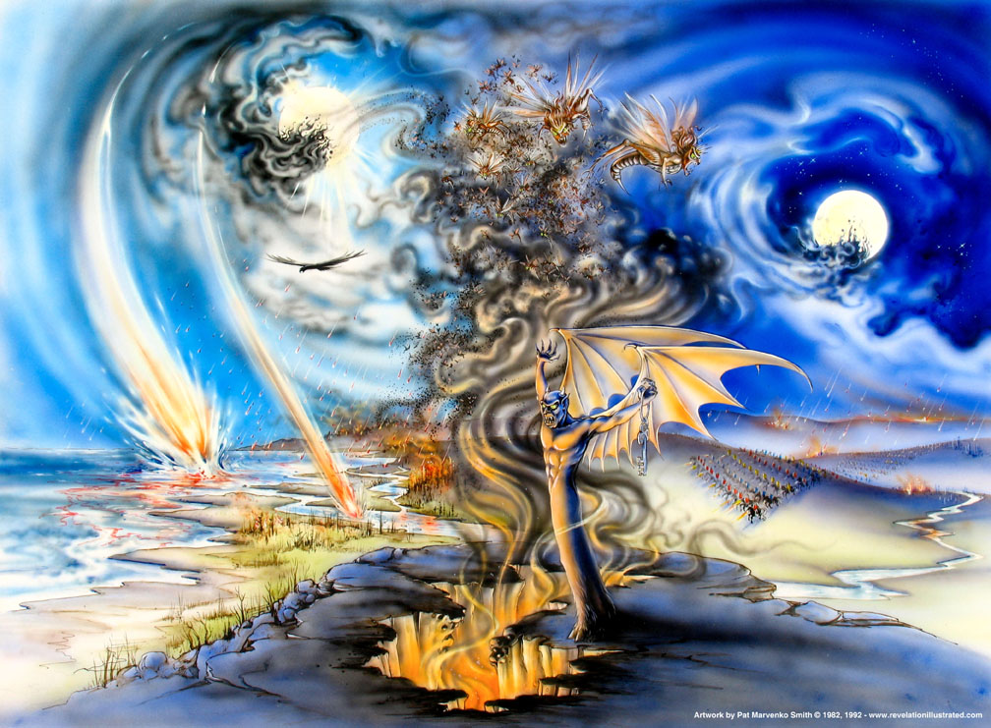
Revelation 9

Slide 16
The Tormenting Locusts
Revelation 9
Locusts were a common pest in that day.
From the time of Moses they were the instruments of divine judgment as in Exodus 10:4-15
Various illustrations in the Bible are drawn from their characteristic features (Deuteronomy 28:38; Joel 2:1-11, 25; 2 Chronicles 7:13; Psalms 105:34; Nahum 3:15).
These locusts that could sting like a scorpion were emerging from the bottomless pit, causing great pain.

Slide 17
The Tormenting Locusts
Revelation 9
Tormenting locusts arise from the pit out of the smoke.
Power over only those not numbered with the 144,000 (sealed).
Given power as the scorpions on earth have power
They are not to eat the earth’s vegetation, grass, or any green thing.
Their mission is to hurt and torment.

Slide 18
The Smoke and Darkness
Revelation 9
Smoke and darkness tend to “blind” men.
This plague of evil causes men to be blind to their sins.
Sin has a vicious sting – it hurts, but it is not yet fatal. cf. Galatians 6:7-8
Proverbs 13:15-16, “Good understanding giveth favor; But the way of the transgressor is hard. Every prudent man worketh with knowledge; But a fool flaunteth (his) folly.”
Those who subjected God’s people to much torment will receive much worse in return!

Slide 19
Revelation 9:5
Revelation 9
“And it was given them that they should not kill them, but that they should be tormented five months: and their torment was as the torment of a scorpion, when it striketh a man”

Slide 20
Revelation 9:6
Revelation 9
“And in those days men shall seek death, and shall in no wise find it; and they shall desire to die, and death fleeth from them.”

Slide 21
Mission of the Locusts
Revelation 9
Power is limited for only “five months.”
Commanded not to kill – just torment.
Torment is like a scorpion’s sting.
For some extended period of time, men will experience something worse than death.
Death would be preferred, but it cannot be found. (cf. 6:15-16; cf. Luke 21:26, Matthew 24:22, and Mark 13:12, 20)
Could it be the “inner corruption” that leads to moral and spiritual decadence?

